Slide 1
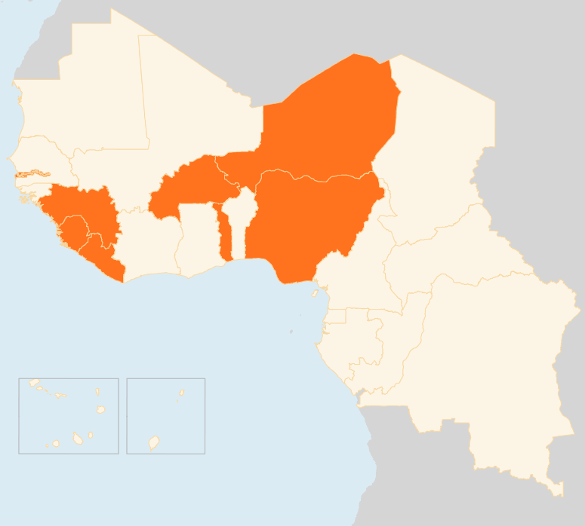


28 April – 5 May 2015
BURKINA FASO
160,000 POULTRY EGGS DESTROYED TO PREVENT AVIAN FLU SPREAD
As a preventive measure against the spread of the Avian Flu epidemic, more than 160,000 eggs were seized and destroyed in Manga, South-Central region. The area had reported the majority of Avian Flu cases in February and March.
GUINEA
NEW PROTESTS IN CONAKRY LEAVE MANY Injured
At least 14 persons were injured in Conakry on 3 May when opposition supporters, defying a government ban on demonstrations, clashed with security forces. Weeks of protests against the timing of local and presidential elections have left at least three people dead and many more injured. Opposition leaders have called for nationwide protests.
LIBERIA
400 SUSPECTED MEASLES CASES, NATIONWIDE VACCINATION
As of 1 May, the Ministry of Health reported 400 suspected measles cases in 10 Counties; 67 per cent children are under five. Health partners continue to mobilize support for the integrated nationwide measles, polio and deworming campaign scheduled for 8-14 May.
NIGER
25,000 FLEE LAKE CHAD ISLANDS
According to preliminary figures, 25,000 people have arrived in the towns of Nguigmi and Bosso in south-east Niger, fleeing their homes on small islands in Lake Chad. Most displaced families are settled outdoors and their most urgent needs include shelter, water, food and non-food items. The authorities and humanitarian actors are scaling up their response. Niger authorities last week urged Lake Chad residents to evacuate the islands over security fears, a week after a Boko Haram assault left at least 74 dead.
252 killed in Meningitis outbreak
The toll of the 2015 Meningitis outbreak continues to worsen. Since January, a total of 3,304 cases have been registered country-wide, resulting in 252 deaths. A mass vaccination campaign is underway.
NIGERIA
Internal Displacement reaches 1.5 MILLION
The number of internally displaced persons (IDPs) in the six north-eastern States has risen to nearly 1.5 million, an increase of more than 300,000 since February 2015, according to the Displacement Tracking Matrix (DTM) produced by the National Emergency Management Agency (NEMA) and the International Organization for Migration (IOM). Maiduguri, the capital of Borno state, now hosts half a million IDPs.
NEARLY 700 WOMEN AND GIRLS RESCUED FROM INSURGENTS
On 30 April, Nigerian military announced that about 160 hostages had been rescued from Boko Haram insurgents’ hideout in Sambisa Forest in addition to 200 girls and 93 women freed two days earlier. On 2 May, the military declared another 234 were liberated. Boko Haram has lost ground since February when Nigeria and its neighbours stepped up a counter-insurgency offensive.
TOGO
Constitutional court CONFIRMS PRESIDENTIAL VOTE RESULTS
President Faure Gnassingbe has been sworn in for his third term as President of Togo. The country’s constitutional court ruled he had won 58.77 percent of the votes in the election held on 25 April. The results are contested by the opposition leader Jean Pierre Fabre.
REGIONAL / EBOLA VIRUS DISEASE
CASES PLATEAUING
A total of 33 new Ebola cases were reported in the week leading up to 26 April. Forecariah in Guinea and Kambia in Sierra Leone, accounted for 25 of the cases reported. Improved community engagement in these areas is required to ensure that all remaining chains of transmission can be tracked and ultimately brought to an end. Liberia has not reported any infections for the fifth consecutive week and could be declared Ebola-free on 9 May.
BURKINA FASO
160k
POULTRY EGGS DESTROYED IN AVIAN FLU PREVENTION
NIGER
GUINEA
25k
FLEE LAKE CHAD ISLANDS
NEW PROTESTS
IN CONAKRY
NIGERIA
1.5M
PEOPLE DISPLACED
TOGO
REGIONAL / EVD
PRESIDENT SWORN IN, OPPOSITION CONTESTS RESULTS
33
CASES IN GUINEA AND SIERRA LEONE
LIBERIA
400
SUSPECTED MEASLES CASES
Creation date: 05 May 2014
Map data sources: UNCS, DevInfo, OCHA.
The boundaries and names shown and the designations used on this map do not imply official endorsement or acceptance by the United Nations

